Slide 1


Structured Data Capture (SDC)
Overview
Lloyd McKenzie | February 2025

Slide 2

Who am I?
Name: Lloyd McKenzie
Company: Dogwood Health
Background:
One of FHIR’s 3 initial editors
Co-chair FHIR-Infrastructure, past chair FHIR Management Group
HL7 Fellow
Lead for both the ONC and international FHIR SDC projects
lloyd@dogwoodhealthconsulting.com

Slide 3

This presentation
Can be downloaded from the Ontario Health e-Learning site:
https://elearning.ontariohealth.ca/login/index.php
Is licensed for use under the Creative Commons, specifically:
Creative Commons Attribution 3.0 Unported License
Do with it as you wish, so long as you give credit

Slide 4

Credit
These slides include content from Brian Postlethwaite
With updates by Lloyd McKenzie

Slide 5

The SDC Collection
SDC Overview (you are here)
SDC Workflow
SDC Expressions
SDC Rendering & Behavior
SDC Population
SDC Extraction
SDC Adaptive Forms
SDC Modular & Derived Forms

Slide 6

Objectives
You should be able to:
list the key use-cases for forms in FHIR
describe the key resources involved in representing forms in FHIR and how they relate
explain the use of the key data elements that define a Questionnaire
describe the difference between the FHIR core specification and the SDC implementation guide
list the key enhancements provided by the SDC IG

Slide 7

Demo and hands-on
NLM LHC form designer & filler
https://lhcforms.nlm.nih.gov
Beda Software form designer & filler
https://sdc.beda.software
Telstra Health form designer & filler
http://smartqedit4.azurewebsites.net

Slide 8
SDC Overview Outline
Forms in FHIR
FHIR Form Resources
Structured Data Capture
Authoring Exercises

Slide 9
SDC Overview Outline
Forms in FHIR
FHIR Form Resources
Structured Data Capture
Authoring Exercises

Slide 10
Forms in Healthcare
Assessments (Primary Care)
Assessments (consumer)
“Patient Reported Outcomes”
Case Report Forms
Gov't/Statutory forms
Referrals template
Pre-determination/Claims Forms
Admission forms
Satisfaction survey
Surgical checklists
Public Health Reporting
Insurance/Payments
General data entry

Slide 11
Why use forms?
AllergyIntolerance
Condition
Encounter
FamilyMemberHistory
MedicationStatement
Observation
Patient
100+ other resources
QuestionnaireResponse
or

Slide 12
Forms provide:
Tight control over user experience:
How questions are phrased
What answer choices are permitted
What gets asked when (and in what order)
User interface ‘appearance’
i.e. Consistency in data capture
Full flexibility in what data is captured and how
Very simple data model

Slide 13
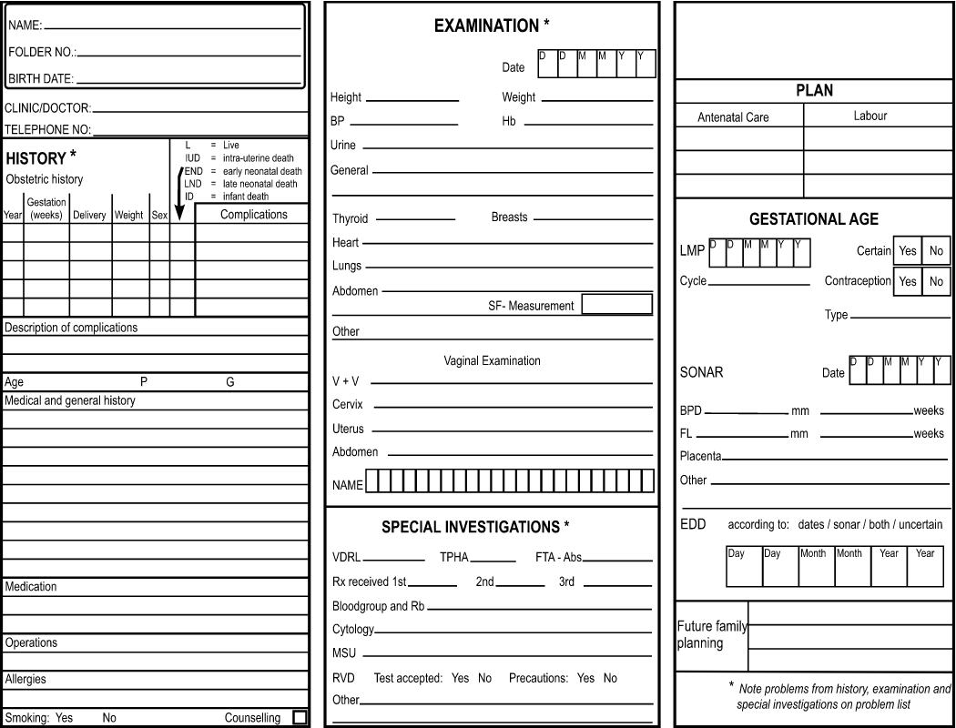
Forms for display

Slide 14
Why use anything other than Forms?
Questionnaire responses aren’t “standard”
Inconsistent over time (different form ‘versions’)
Forms change fairly often
Inconsistent across organizations
Meaning of elements influenced by previous questions
“Address” means different things depending where it appears on the form
In general, can’t query QuestionnaireResponse based on what the answers are

Slide 15
Common pattern
Use forms to capture data
Especially when using ‘simple’ clients
Possibly use ‘population’ to suck in data from existing records
Extract data from form into other resources
Use Provenance to track where the data came from
Primarily pass around other resources
Can pass around Provenance and original QuestionnaireResponse if needed

Slide 16
SDC Overview Outline
Forms in FHIR
FHIR Form Resources
Structured Data Capture
Authoring Exercises

Slide 17
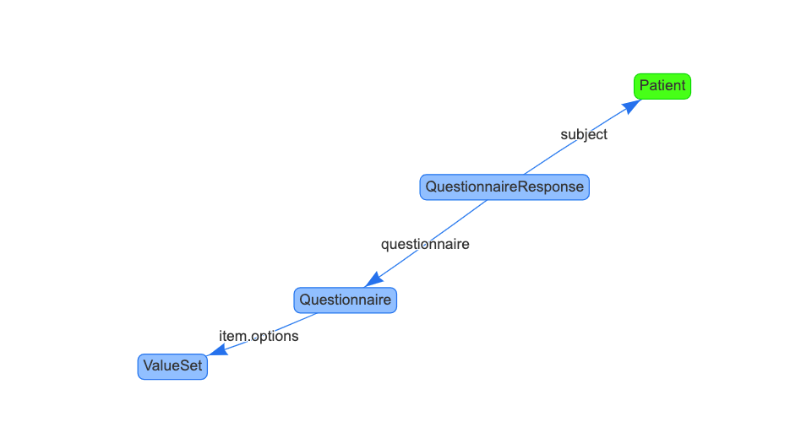
FHIR Questionnaire Resources
Questionnaire
Defines the fields in the form
Value Set
Allowed answers
QuestionnaireResponse
Specific set of answers
Other
Extensions, Operations, Profiles, Implementation Guides (incl SDC)
Notes:
Incomparing to StructureDefinition, note that you typically don’t need to profile Questionnaire to create a new form…

Slide 18
Questionnaire
Used to represent forms/surveys/case report forms/etc.
Can capture any sort of information
clinical, administrative, financial, research, public health…
Hierarchical collections of questions
May include ‘groups’ and instructions/guidance
Control over allowed answer optionality, repetition, data type, options
Some elements might be conditional
e.g. “if question 2=female, then display question 5”

Slide 19
Structure of a Questionnaire
Questionnaire
Metadata
Item
(Group, Question or
Display)

Slide 20
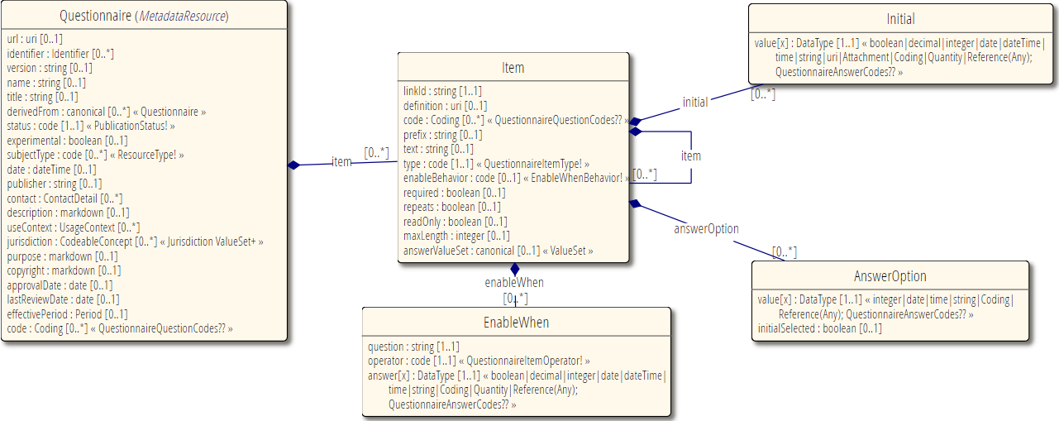
Questionnaire

Slide 21
Types of item
Groups
Organize content of questionnaire
Must have children
Can’t have answers
Questions
Solicit information
Must have answers (but can be optional)
Display
Additional text, no children, no answers

Slide 22
Anatomy of a Question
5.a) What pizza toppings would you like?
(choose at least 1)
Cheese
Ham
Mushrooms
Other
(please specify): ____________
Prefix
Text
Child “display” item (implies required = true, repeats = true)
option or options
Nested “question” item (enableWhen tied to “Other” answer)
Notes:
Options allows you to point to a value set, option allows enumerating individual potential elements

Slide 23
http://hl7.org/fhir/r4/ valueset-item-type.html
Item-Type | Response Type | Definition
group | item(Group) | An item with children, may be repeating. Could be a section, table or other layout (e.g. tabs)
display | (none) | Just a label to be displayed (no answer to be collected)
boolean | valueBoolean | Yes/no answer (checkbox, radio group or similar)
decimal | valueDecimal | Real number answer (restricted textbox, slider, …)
integer | valueInteger | Integer answer (restricted textbox, slider, …)
date | valueDate | Date answer (restricted textbox, date picker …)
dateTime | valueDateTime | Date and time answer (restricted textbox, date picker …)
time | valueTime | Time only answer (hour:minute:second) answer independent of date (restricted textbox, …)
string | valueString | Short free-text answer (single line textbox)
text | valueString | Longer free-text answer, potentially multi-paragraph (multi-line textbox)
url | valueUri | URL (website, FTP site, etc.) answer (restricted textbox)
choice | valueCoding | Coding drawn from a list of options (specified in either the option property, or via the ValueSet referenced in the options property) as an answer (radio buttons, checkboxes, combobox, autocomplete …)
open-choice | valueCoding or valueString | Coding drawn from a list of options (as with the choice type) or a free-text entry in a string (similar controls to choice, except with ability to include textbox)
attachment | valueAttachment | Binary content such as a image, PDF, etc. as an answer (file selector …)
reference | valueReference | A reference to another resource, e.g. practitioner, organization, etc. (resource finder?)
quantity | valueQuantity | Question with a combination of a numeric value and unit. ()
Notes:
The relationship between the answer types, user interface control hints, validation properties, and the data that you should expect coming back
Note that some server’s might accept string values coming back, and chose to convert these.
There is an extension 'http://hl7.org/fhir/StructureDefinition/questionnaire-unit' that can be used to define what unit would be captured (or the a unit that has a UCUM conversion from the provided unit)
Also note that the http://hl7.org/fhir/StructureDefinition/questionnaire-itemControl extension also provides additional guidance to a renderer on what controls it would like to be used to best capture the data

Slide 24
Interaction with terminologies
Extensions
Questionnaire structure
questionnaire-optionExclusive
preferredTerminologyServer
questionnaire-unitValueSet
11179-permitted-value-valueset
11179-permitted-value-conceptmap
Operations
Use the ValueSet $expand operation to either pre-load the values, or use the filter parameter for the auto-complete style usage
Item types
Choice, open-choice
Valueset reference (canonical!)
Item.answerValueSet
Answer options
valueCoding
Control selection
Consider the number of potential entries in the list
Checkboxes, radio buttons, comboboxes, autocomplete
Notes:
Open-choice gives the option of recording a free text value.
If no tx server extension, then presume same server you got the Questionnaire from.
Might not need tx if expansion is provided

Slide 25
QuestionnaireResponse
A single (fully or partially) completed form
Ties to exactly one Questionnaire*
Every ‘item’ in the QR points to one item in the Q(by linkId)
Structure of QR must match structure of Q
Lets you see and compare “raw” data

Slide 26
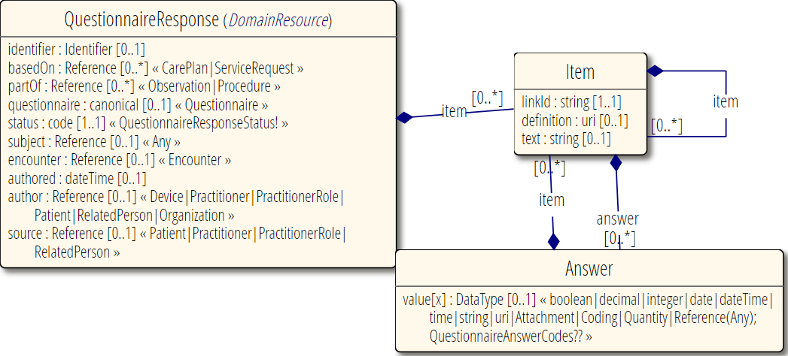
QuestionnaireResponse

Slide 27
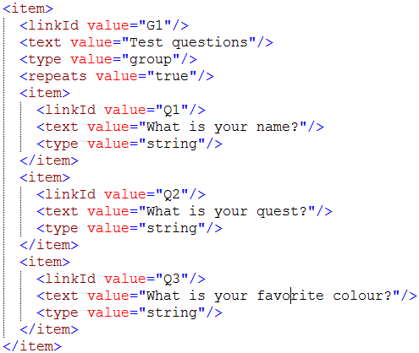
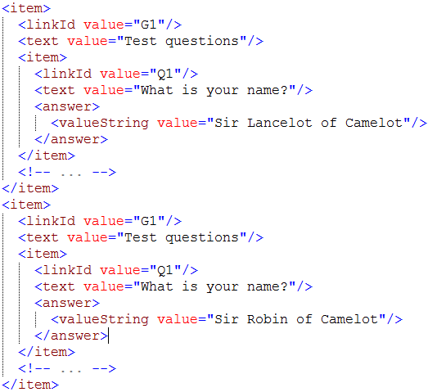
Linking Questionnaire to QuestionnaireResponse
Questionnaire
QuestionnaireResponse

Slide 28
Other relevant resources
CodeSystem & ValueSet:
Allow defining sets of answers that are shared or are externally managed
Codes have both computable and human friendly views
Can have numeric weights for calculations
ConceptMap
Allows defining translations for questions
and helpful for mapping QuestionnaireResponses to other resources
StructureMap
Can be used to map Questionnaire

Slide 29
SDC Overview Outline
Forms in FHIR
FHIR Form Resources
Structured Data Capture
Authoring Exercises

Slide 30
What is Structured Data Capture (SDC)?
Standardize/enhance capabilities of FHIR Questionnaires:
Workflow
Complex form rendering
Complex form behavior
Automatically populating forms
Automatically extracting data from completed forms
Adaptive forms
Modular forms
Form derivation

Slide 31
Exploring the SDC spec
http://hl7.org/fhir/uv/sdc

Slide 32
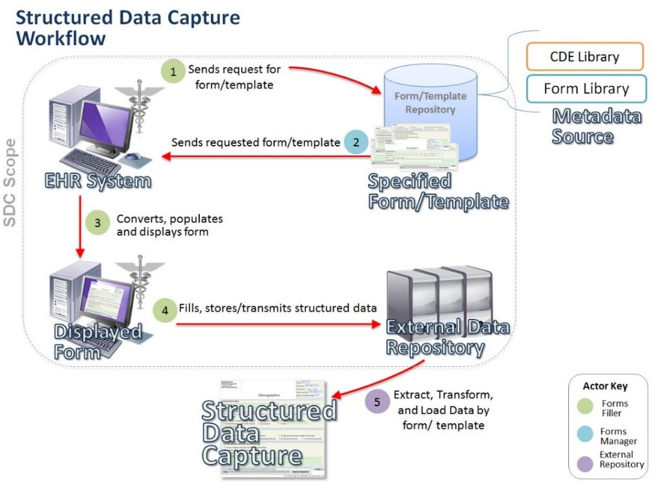
IHE SDC

Slide 33
HL7 SDC vs. IHE SDC
HL7
IHE
XML, JSON, or TTL – standard resources
Questionnaire definition & response are separate
Populate via different mechanisms from any FHIR data, continuous population possible
Integrates with standard FHIR workflow
XML only. Custom schema
Questionnaire definition & response are one instance
Populate from CDA, data element references only, initial pop. Only
Custom workflow

Slide 34
SDC Overview Outline
Forms in FHIR
FHIR Form Resources
Structured Data Capture
Authoring Exercises

Slide 35
Exercise 1
https://lhcforms.nlm.nih.gov
Complete a QuestionnaireResponse
Using LHC Forms SMART App
Complete a U.S. Surgeon General family health portrait
Think about what item types are used, how the form is structured
Fill in multiple repetitions at each layer possible
Show as QuestionnaireResponse
Look at the accompanying Questionnaire

Slide 36
Exercise 1 - Discussion
Trace the linkage between linkIds in Questionnaire and QuestionnaireResponse

Slide 37
Exercise 2
https://lhcforms.nlm.nih.gov
Create a Questionnaire
Using the LHC Form Builder
Create a form that represents the form on the following page

Slide 38
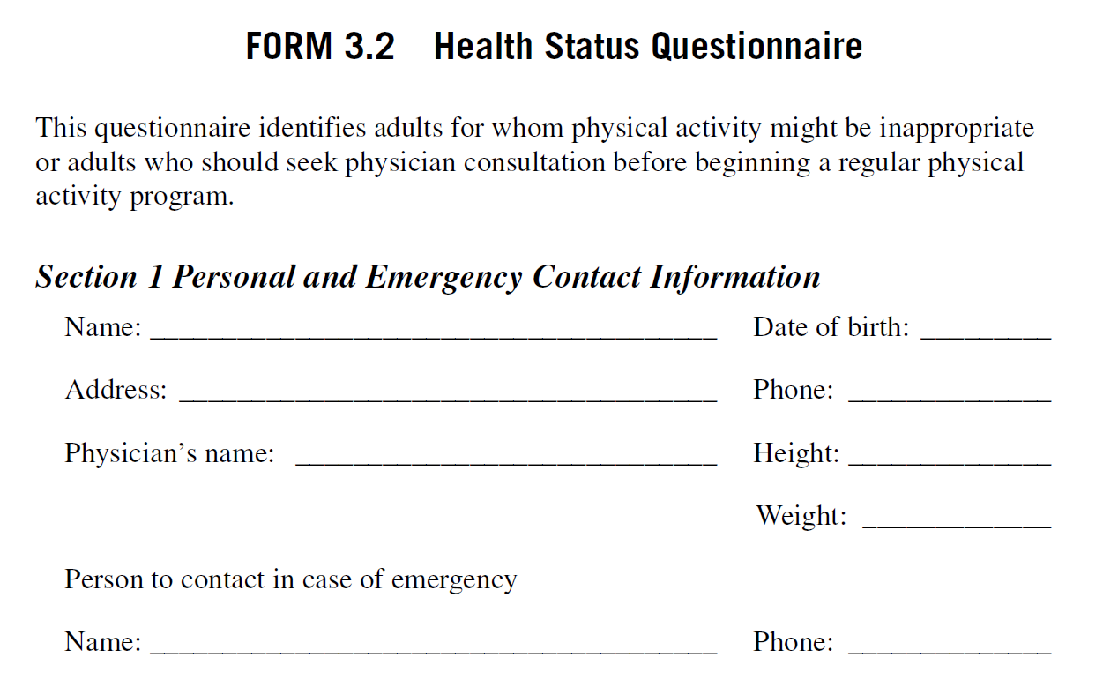
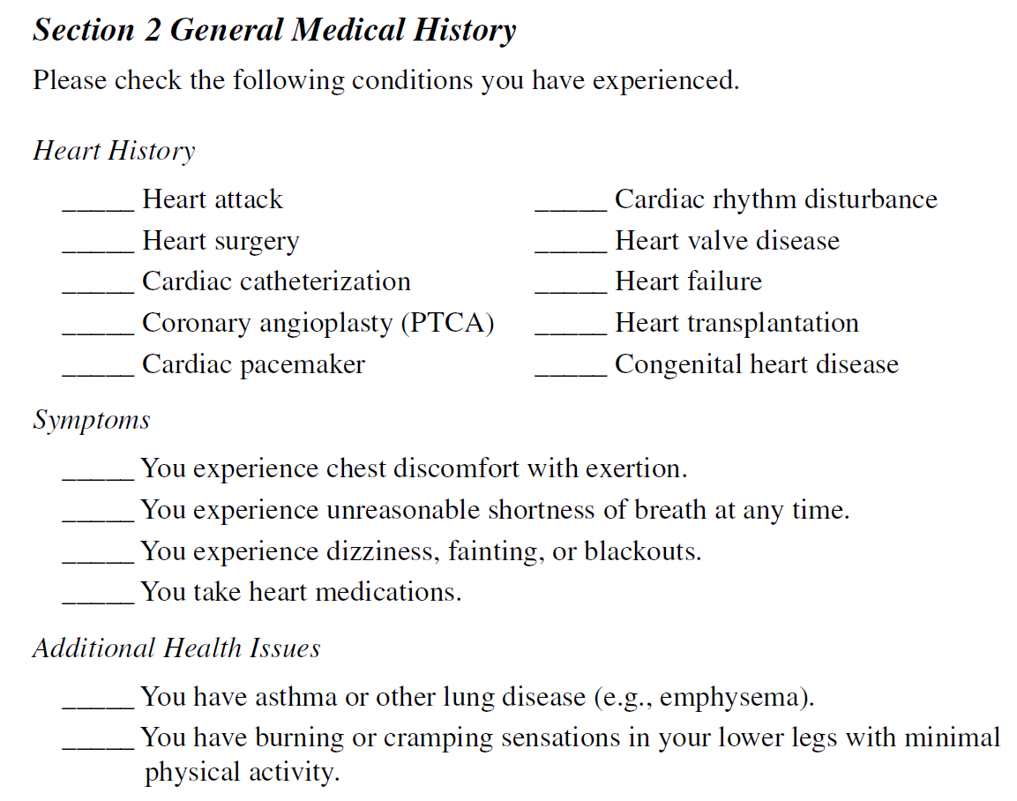
Excerpted from https://www.sampleforms.com/health-questionnaire-form.html

Slide 39
Exercise 2 - discussion
How did you decide what was optional vs. required?
Did you make anything repeating?
How would the design of the form change if you wanted to populate FHIR resources?
Are height & weight each one question or two? Simple type or Quantity?
What codes did you use for medical history?
Does Address make sense as a single field?
How does the rendering of the Questionnaire differ from the original form?

Slide 40



Questions / Discussion
lloyd@dogwoodhealthconsulting.com http://hl7.org/fhir/uv/sdc
Or, better yet, include the community and ask/discuss on https://chat.fhir.org/#narrow/channel/179255-questionnaire

